Slide 1
Personae
Text Annotation and Machine Learning SaaS tool for local government and beyond
by Bryan Quandt

Slide 2
Story 1
Local government planner

Slide 3
Story 2
Public engagement consultancy

Slide 4
The need
Local government staff get public input in surveys, phone calls, written forms, emails, and more
Consultants too
They want to get the main ideas from those comments

Slide 5
Current solution
Excel - comments in rows, themes in columns, “1” denotes when column matches a theme
Pain points
Hard to keep track of while doing
Takes time
Requires double-checking, usually by others

Slide 6
Example

Slide 7
Opportunity
Save local gov staff time
Freeing them up to do more good - design and implement services
Easier to understand input -> more willingness to engage
Transform how gov makes sense of text
Beyond local government
Beyond text

Slide 8
How we get there

Slide 9
1
Coding text with good UI

Slide 10
2
Machine Learning algorithm (KNN?) to analyze written comments

Slide 11
3
Beyond basic text input; potentially including email, voice, etc.

Slide 12
4
Mobile & field capture

Slide 13
Key Functionality
Phase 1

Slide 14
Code text comments

Slide 15
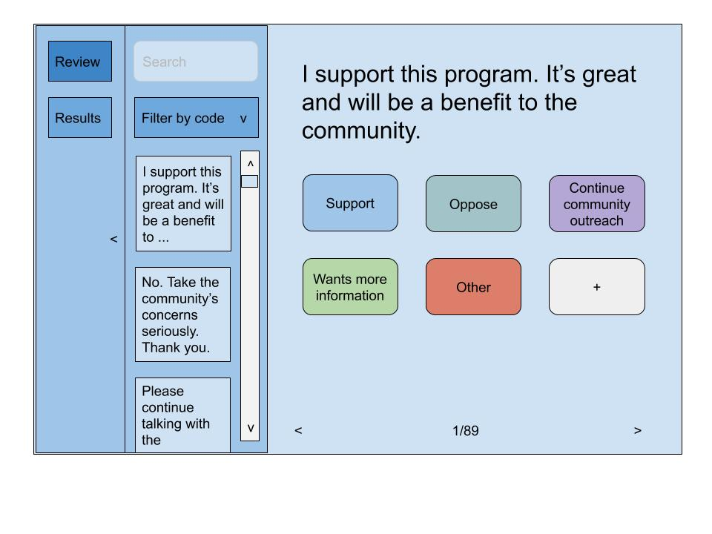

Slide 16
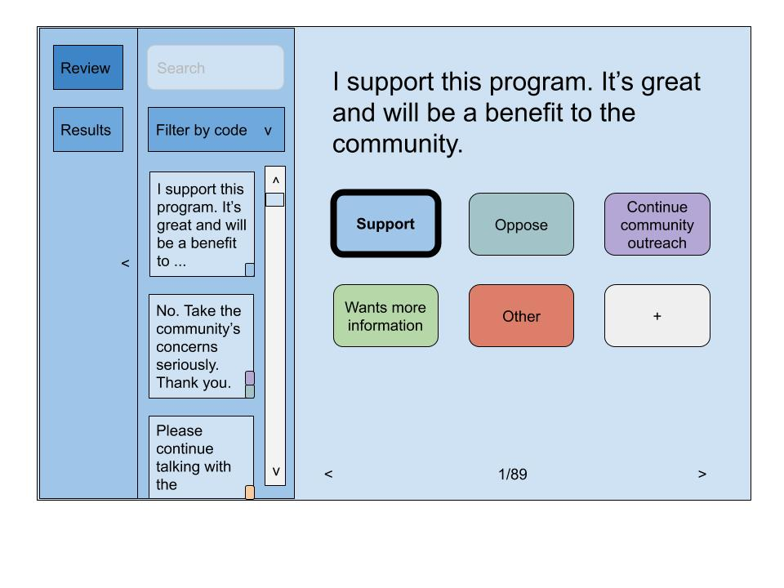

Slide 17
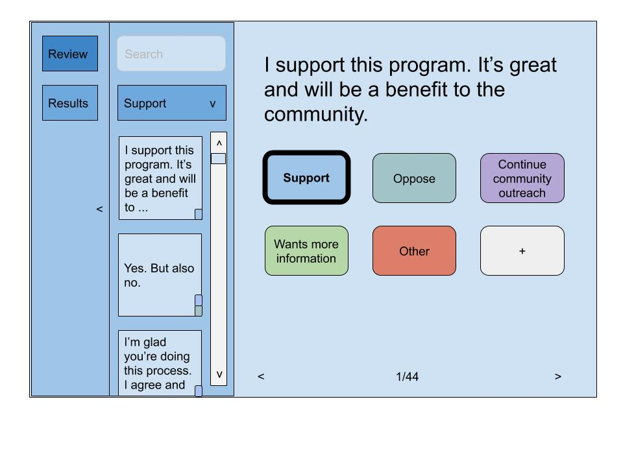

Slide 18
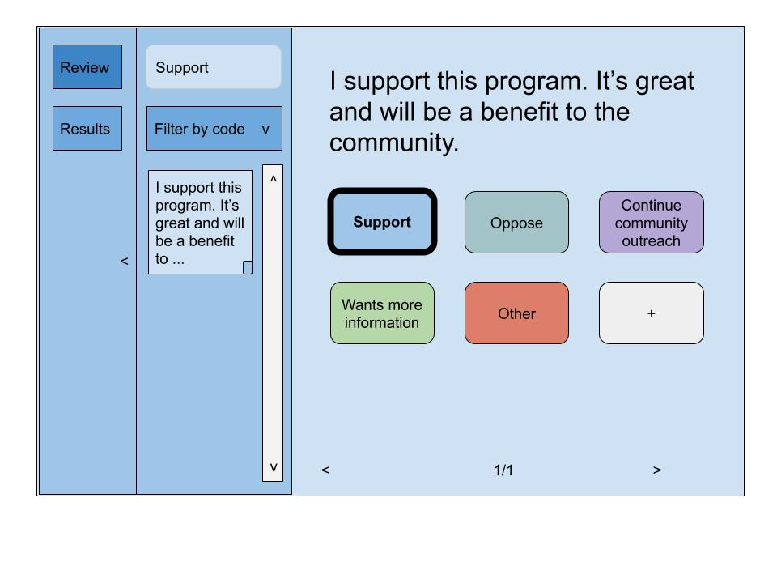

Slide 19
See results

Slide 20
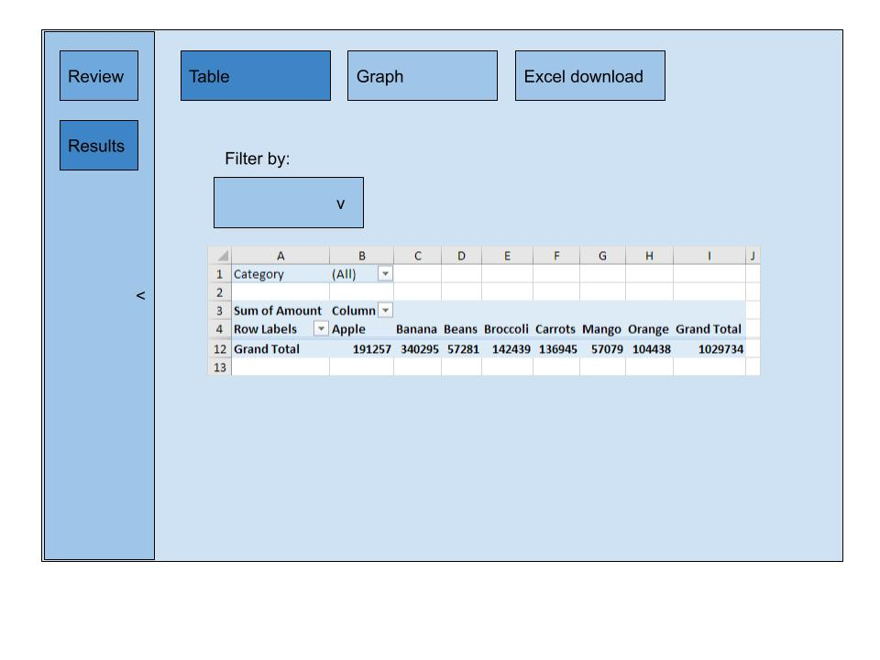

Slide 21
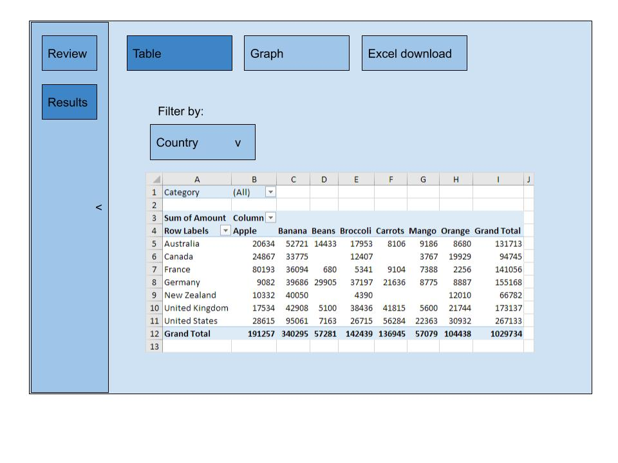

Slide 22
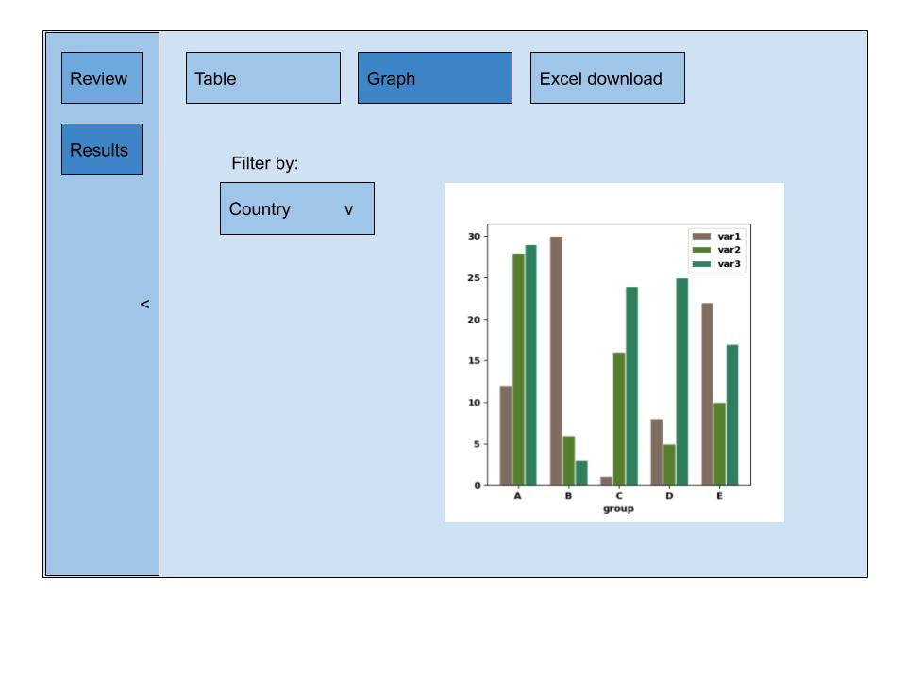

Slide 23
Other Features

Slide 24
Create project

Slide 25
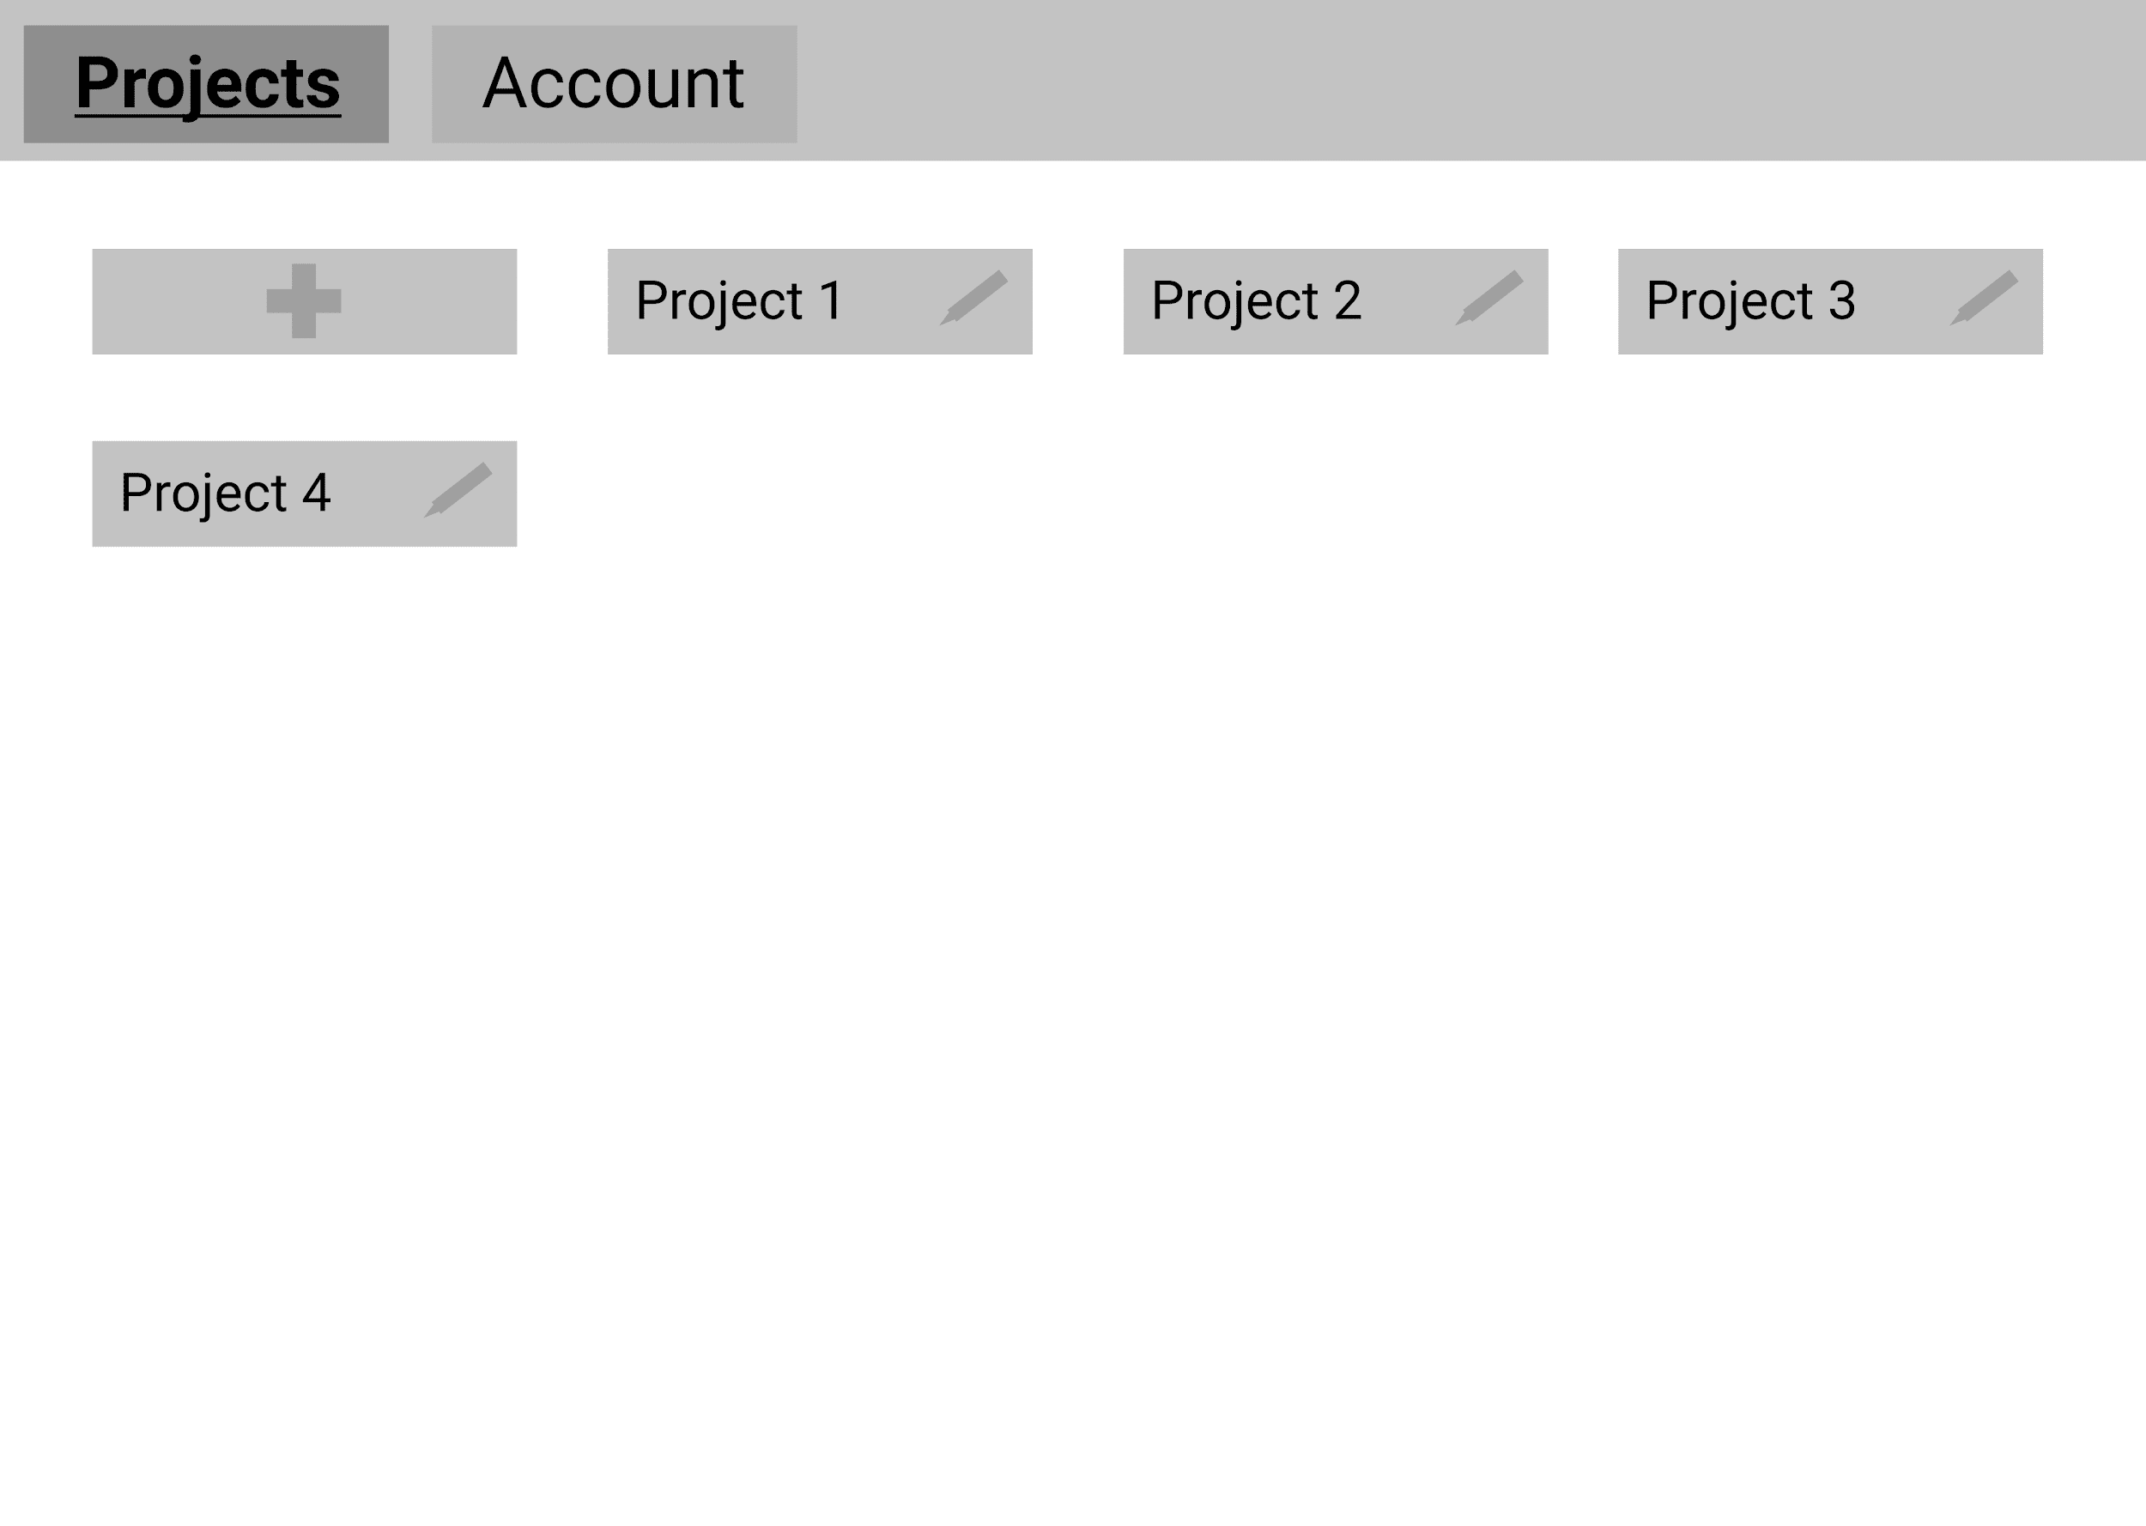

Slide 26
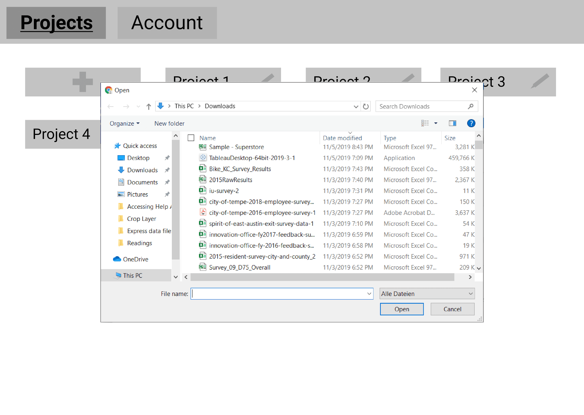

Slide 27
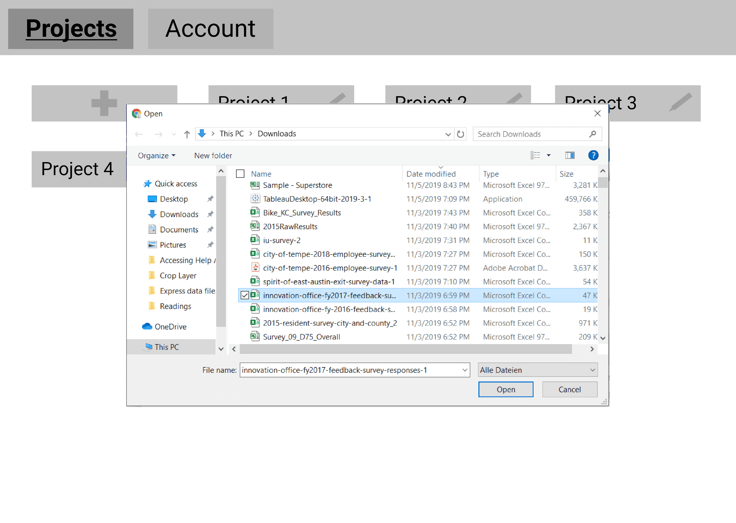

Slide 28
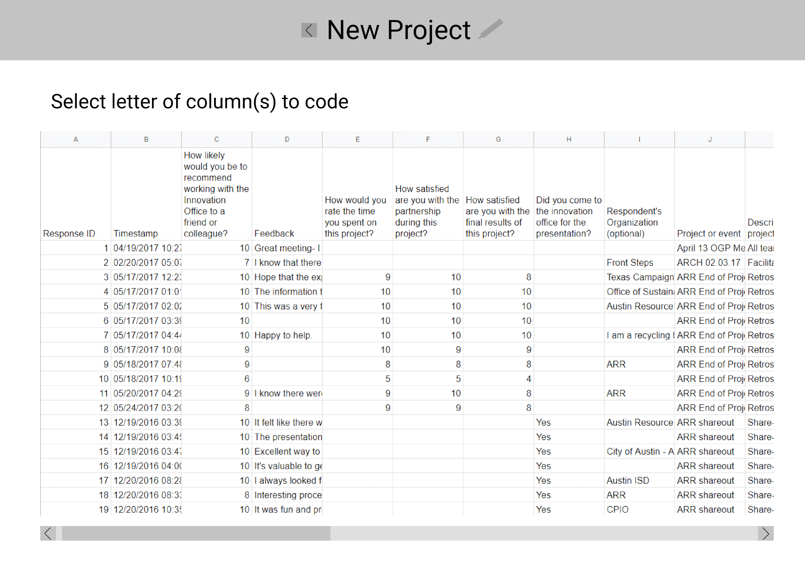

Slide 29
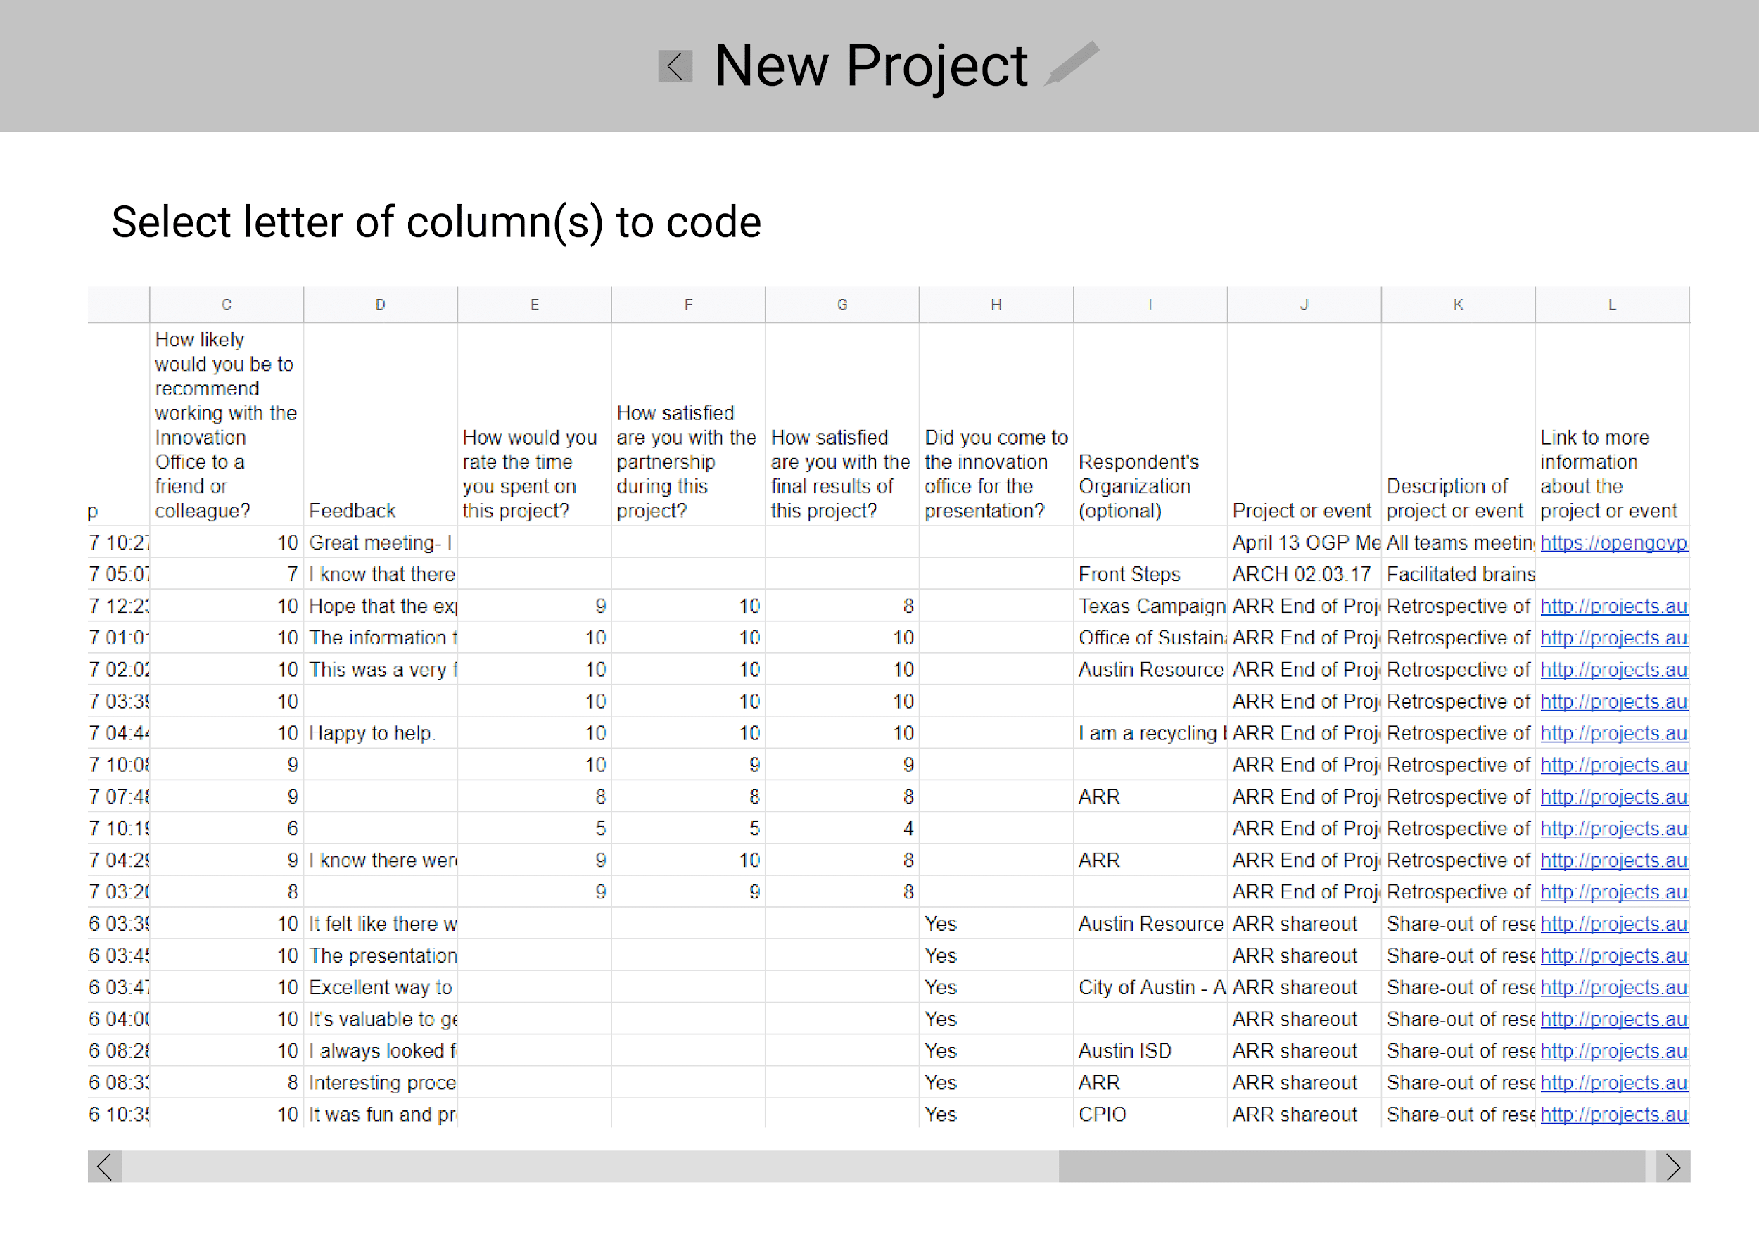

Slide 30
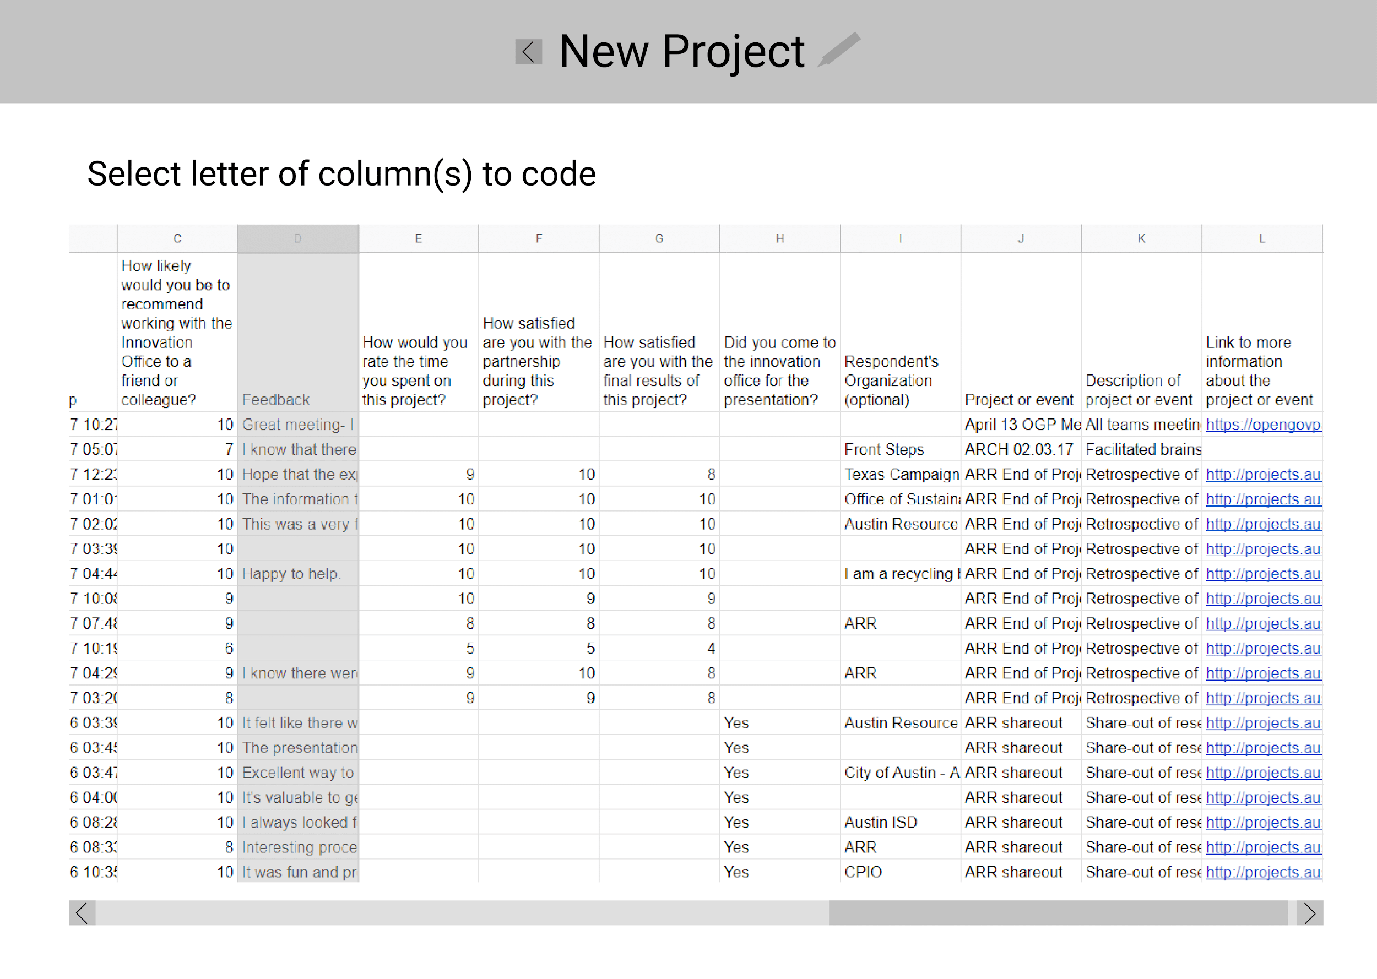

Slide 31
Add code

Slide 32
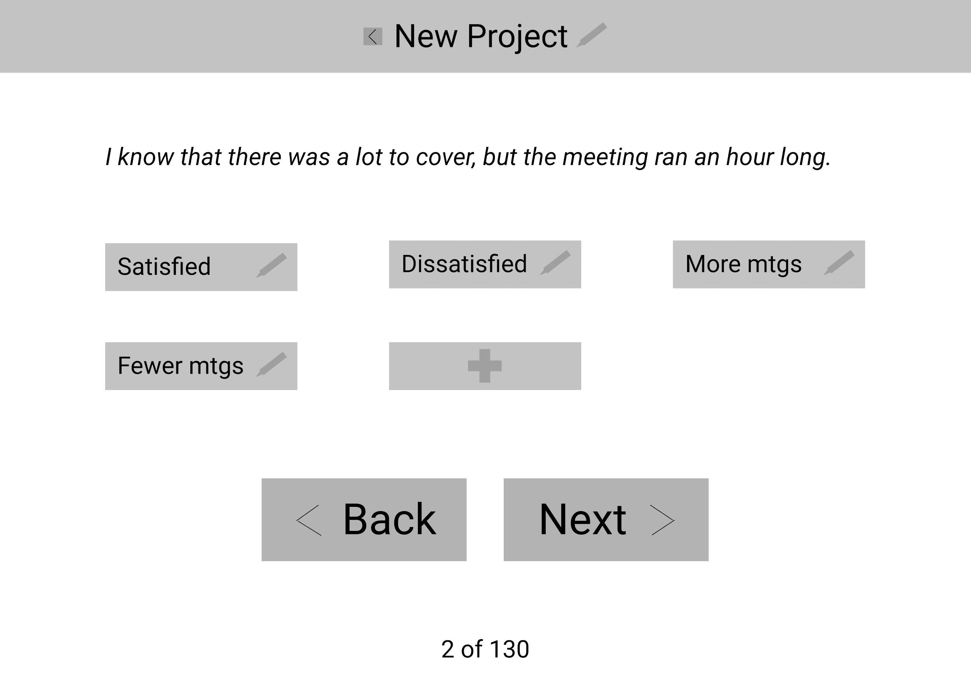

Slide 33
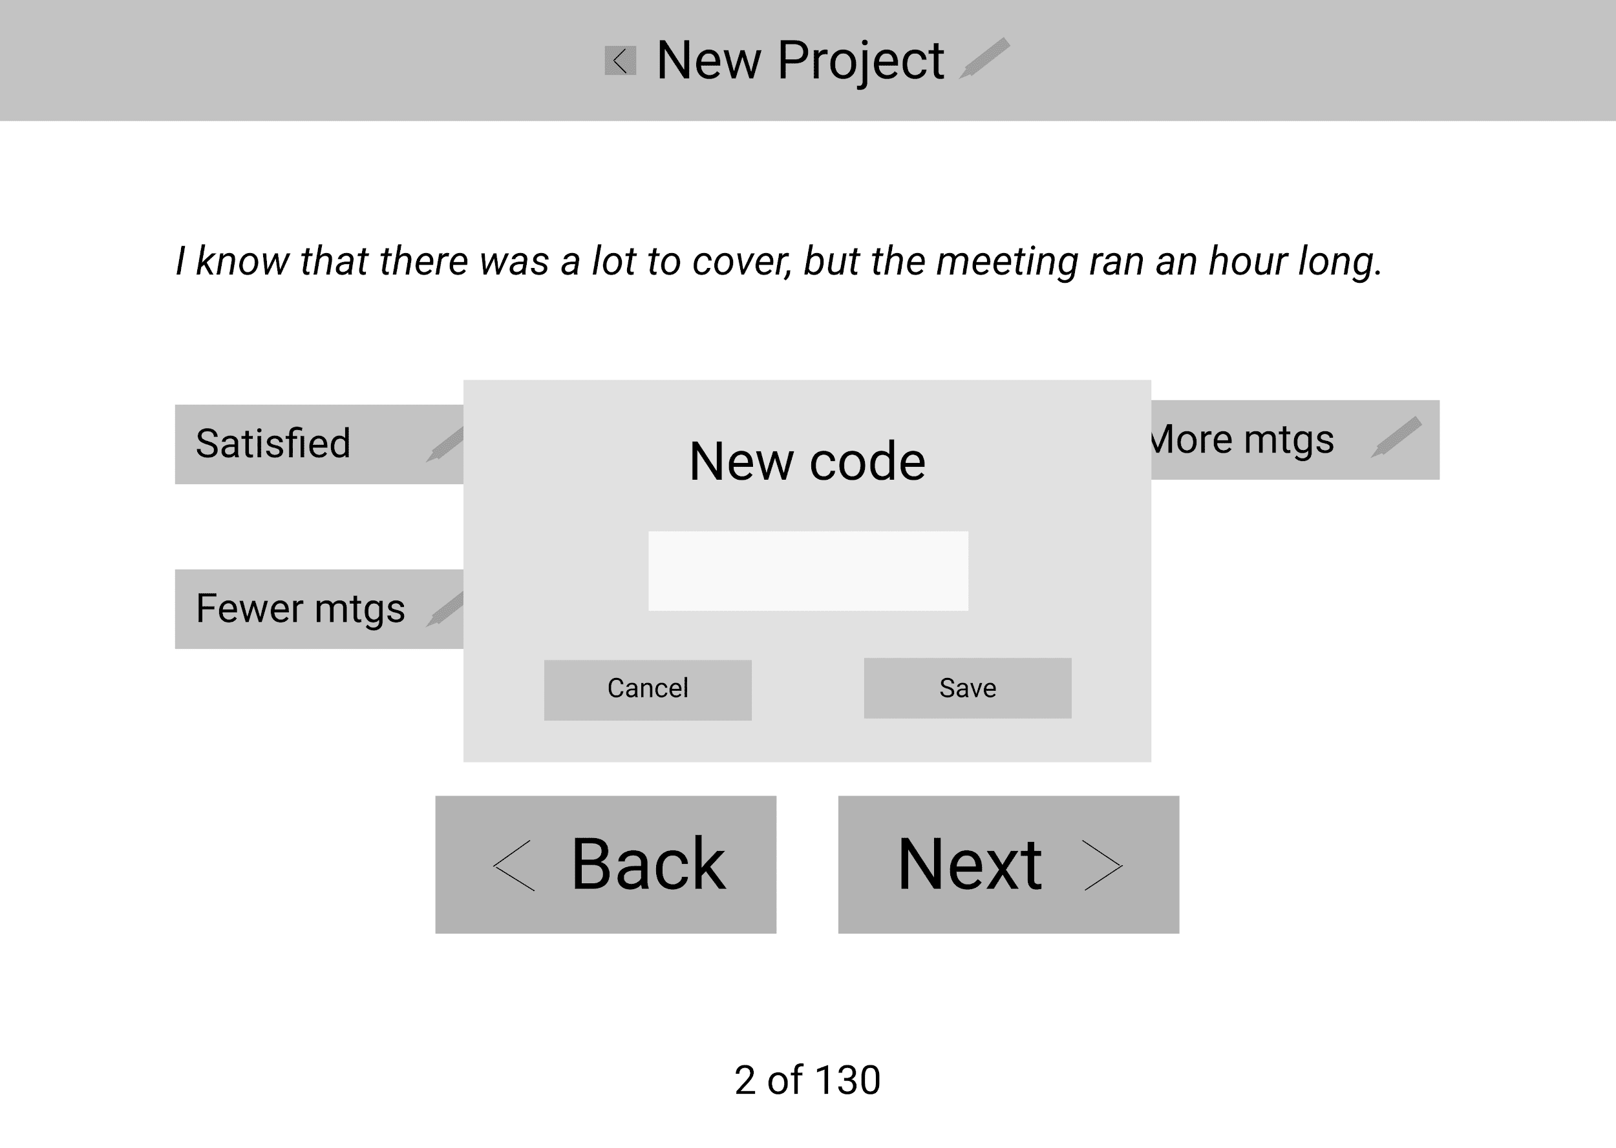

Slide 34
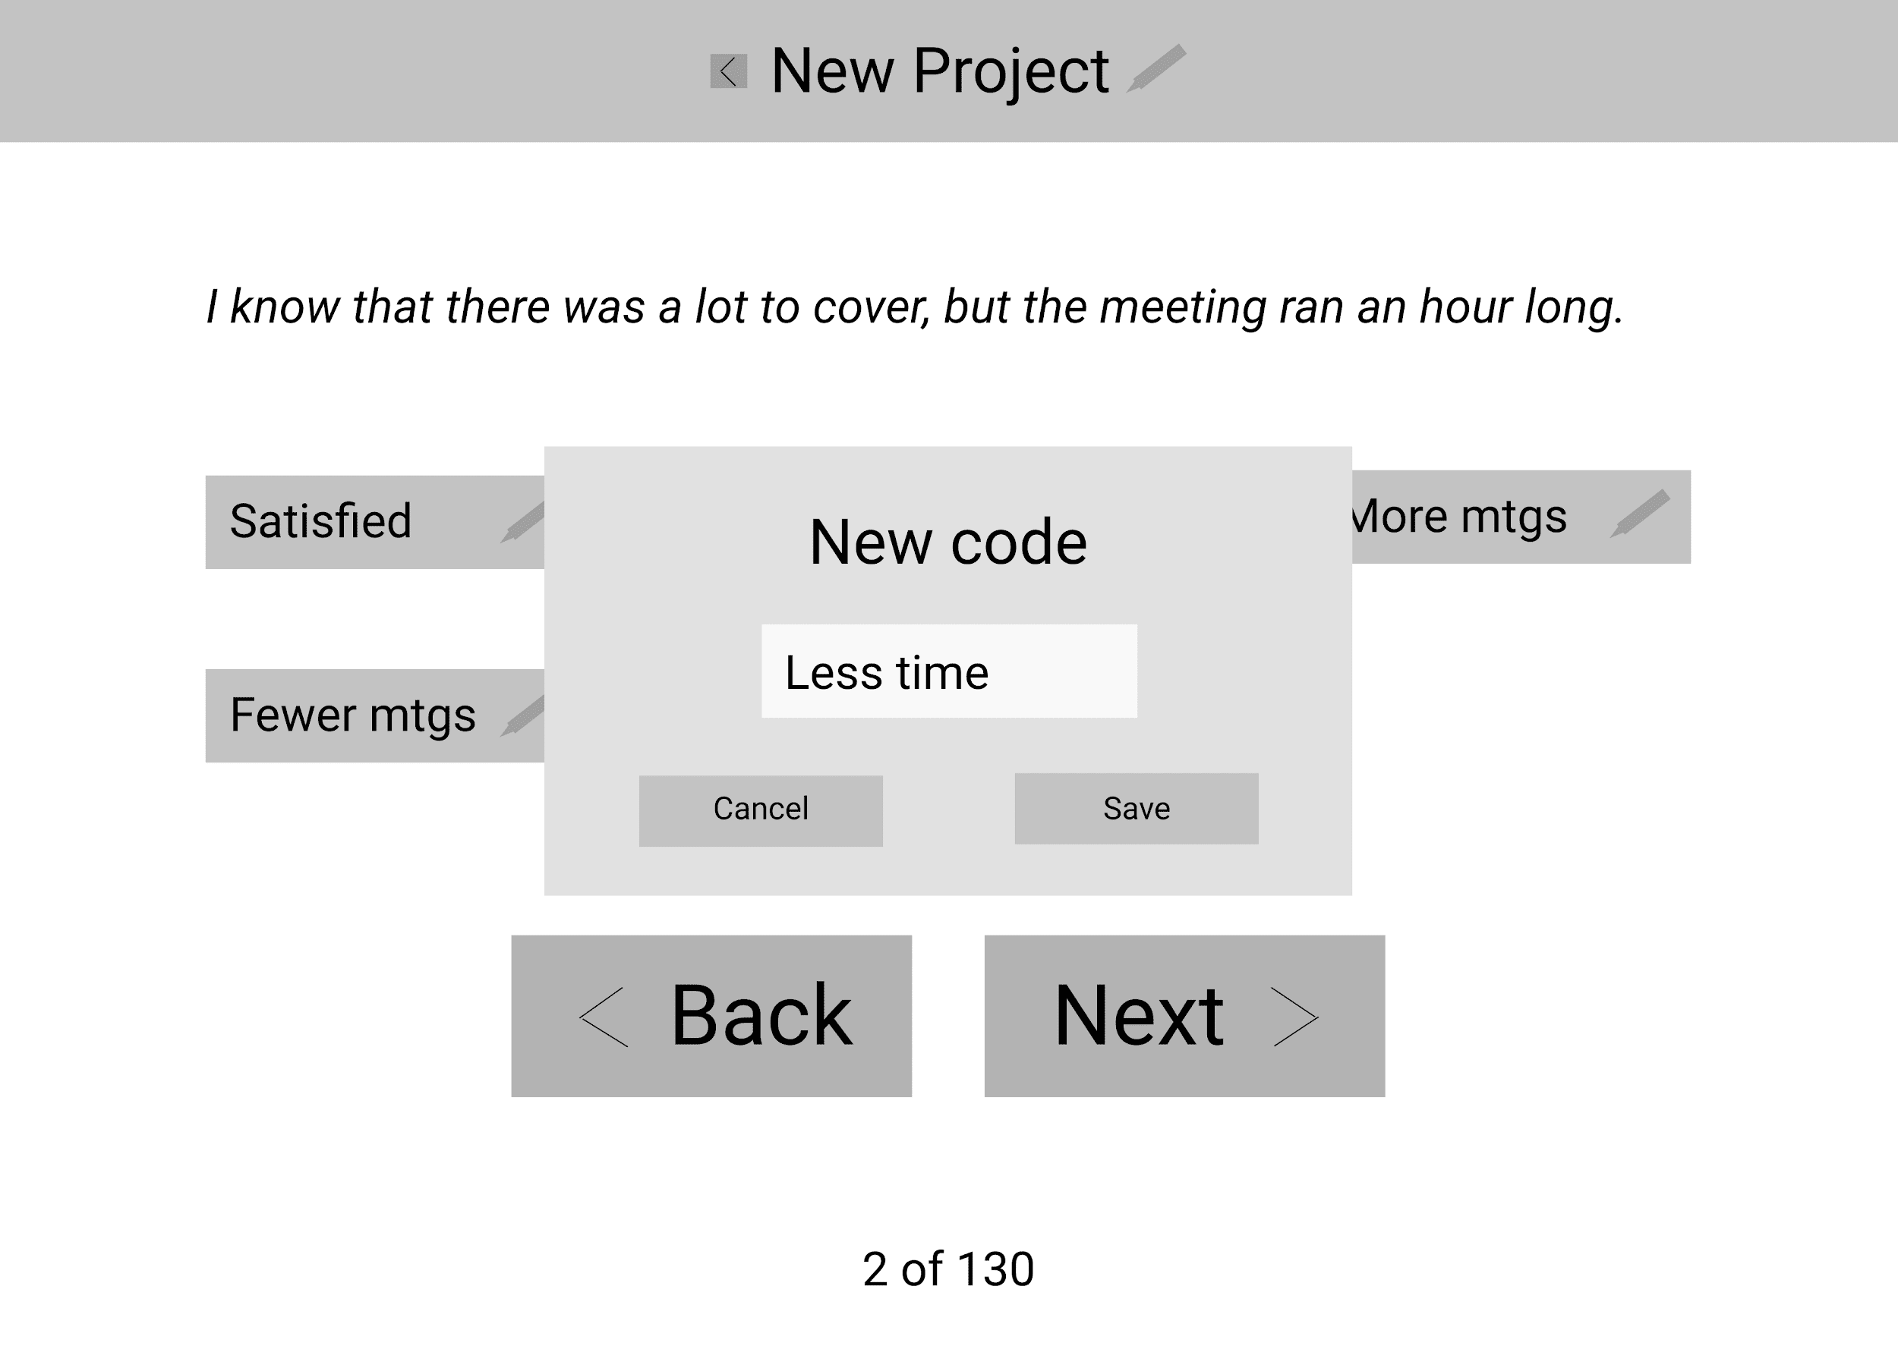

Slide 35
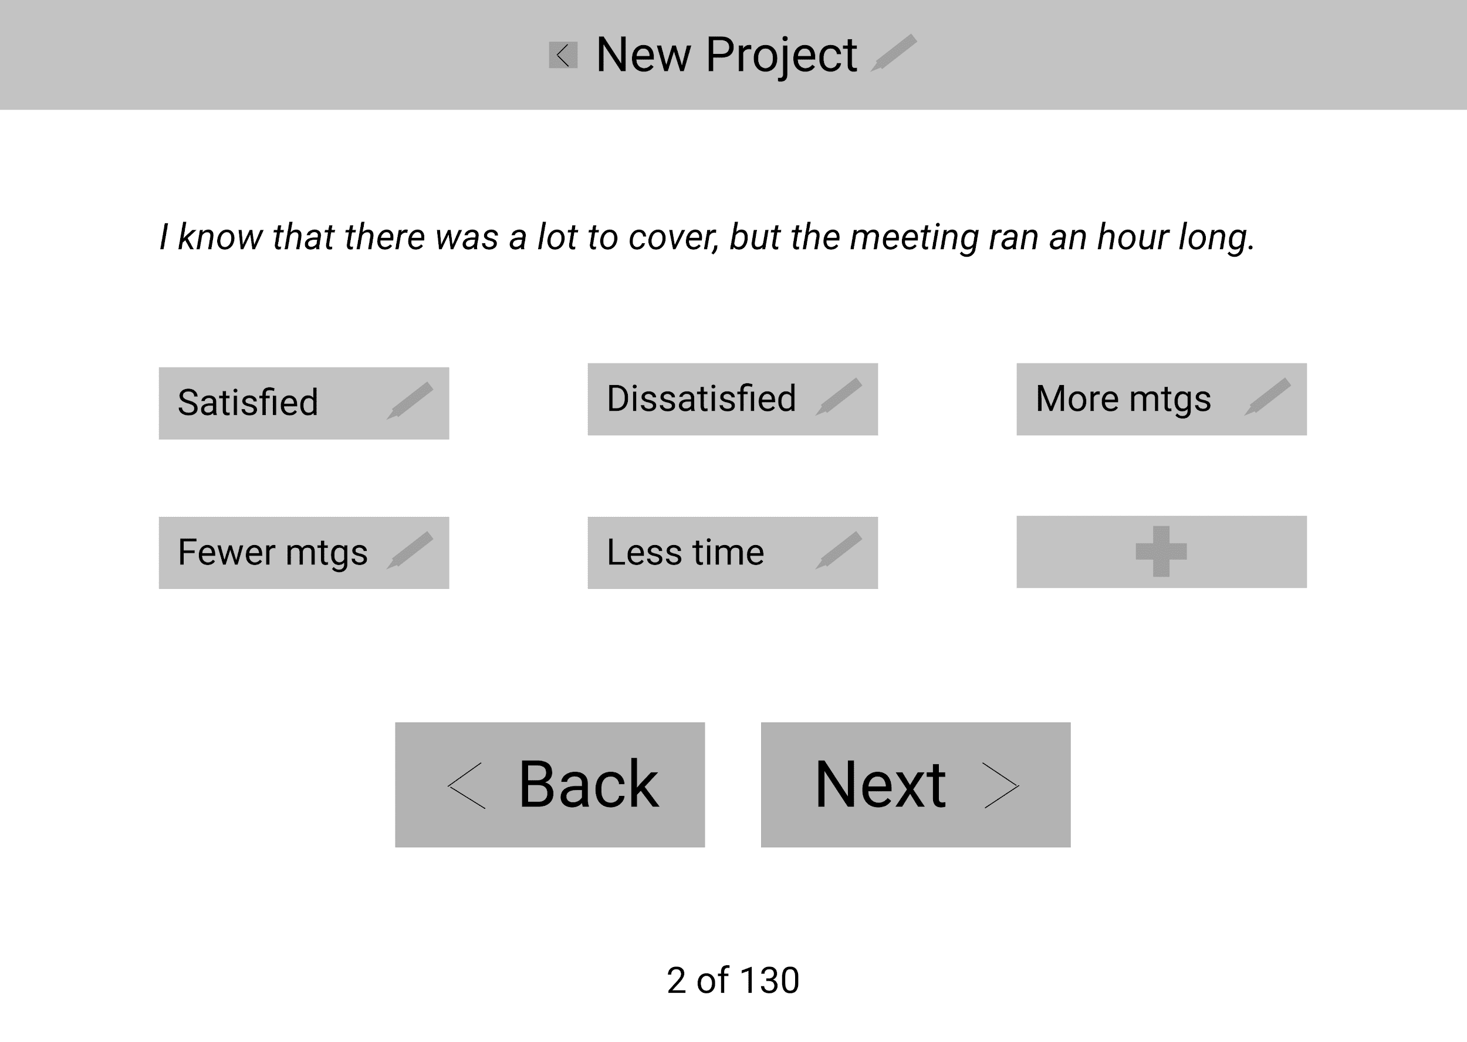

Slide 36
Rename code

Slide 37
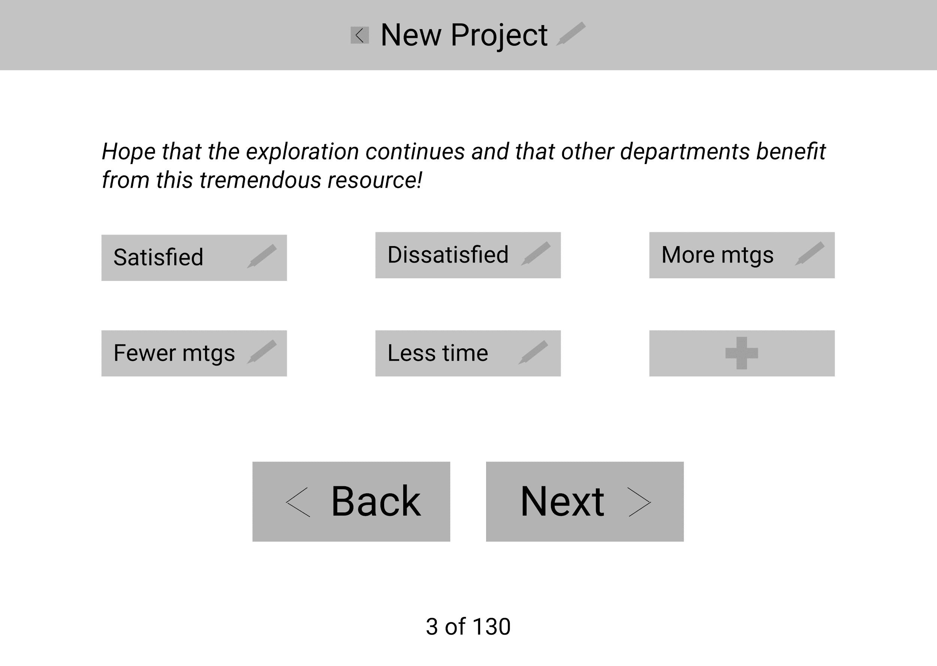

Slide 38
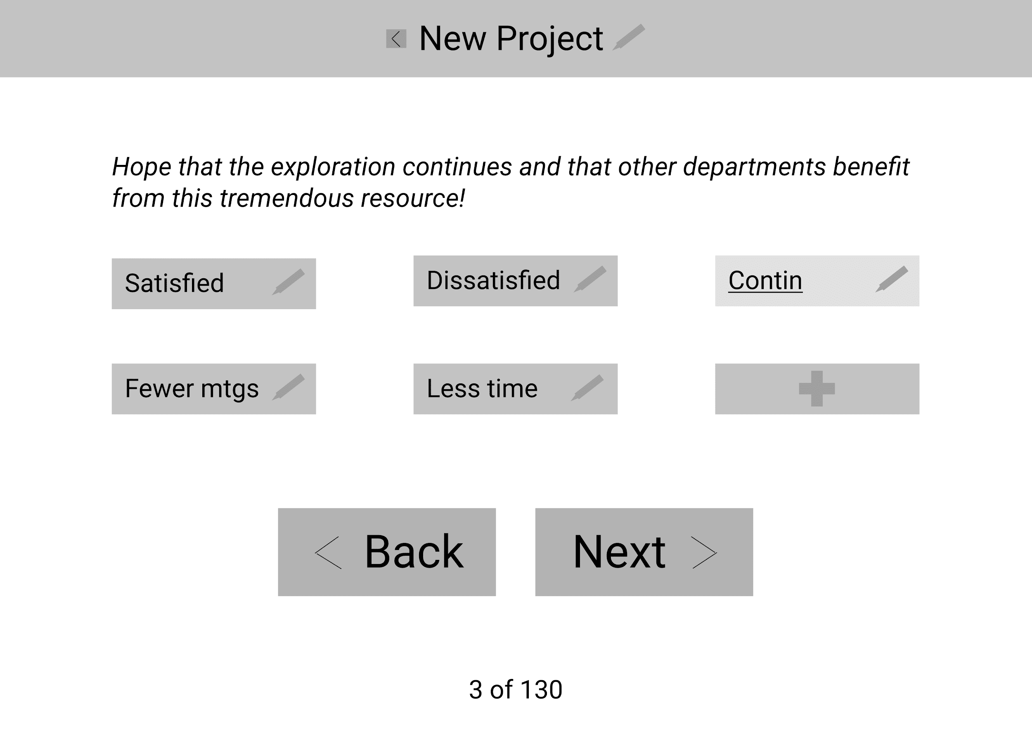

Slide 39


Slide 40
Select multiple codes

Slide 41
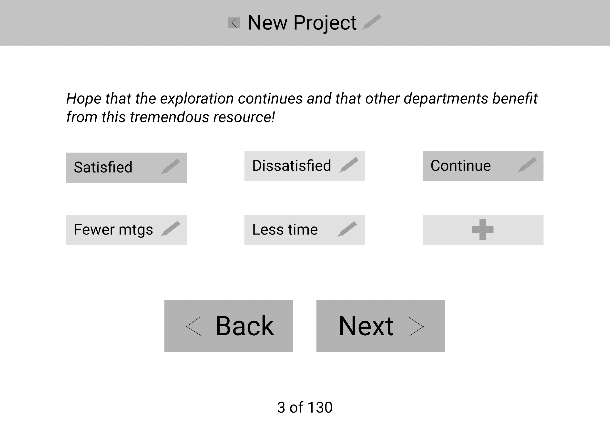

Slide 42
Create account (BE)

Slide 43
Next Steps
Notes:
Bryan send slide deck to Christian, Shawn
Introduce others to slide deck - Shawn and Christian
Draft sign-up & create account flow; bring that to meeting on Wednesday, 2/26 - Bryan
Generate ideas of how BE would work - Bryan, Christian, Shawn
Meet again on next Wednesday, Feb 26, with everyone who’s interested - all
After that, do wireframes, estimates, etc.

